Slide 1
AWS

Slide 2
Elastic Load Balancing & Auto Scaling Groups

Slide 3
Scalability & High Availability
• Scalability means that an application / system can handle greater loads
by adapting.
• There are two kinds of scalability:
• Vertical Scalability
• Horizontal Scalability (= elasticity)
• Scalability is linked but different to High Availability
• Let’s deep dive into the distinction, using a call center as an example

Slide 4

Vertical Scalability
• Vertical Scalability means increasing the size
of the instance
• For example, your application runs on a
t2.micro
• Scaling that application vertically means
running it on a t2.large
• Vertical scalability is very common for non
distributed systems, such as a database.
• There’s usually a limit to how much you can
vertically scale (hardware limit)

Slide 5
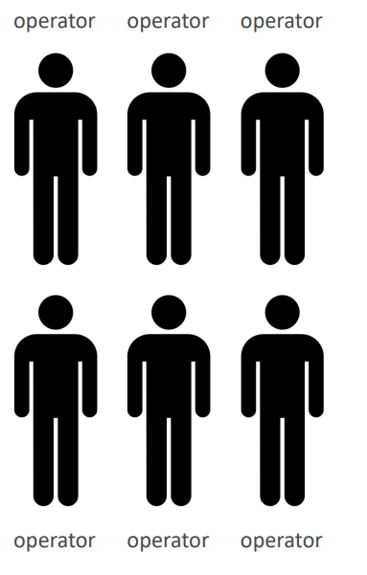
Horizontal Scalability
• Horizontal Scalability means increasing the
number of instances / systems for your
application
• Horizontal scaling implies distributed systems.
• This is very common for web applications /
modern applications
• It’s easy to horizontally scale thanks the cloud
offerings such as Amazon EC2

Slide 6
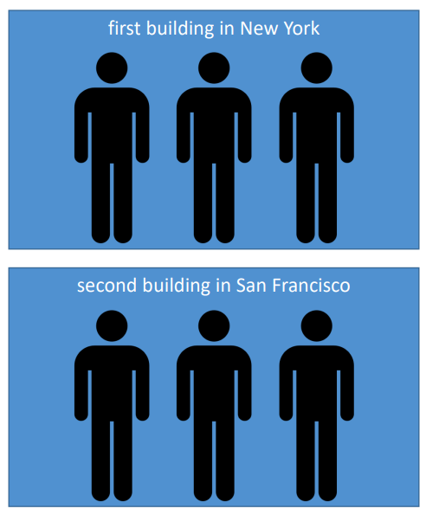
High Availability
• High Availability usually goes hand
in hand with horizontal scaling
• High availability means running
your application / system in at
least 2 Availability Zones
• The goal of high availability is to
survive a data center loss
(disaster)

Slide 7
High Availability & Scalability For EC2
Vertical Scaling: Increase instance size (= scale up / down)
From: t2.nano - 0.5G of RAM, 1 vCPU
To: u-12tb1.metal – 12.3 TB of RAM, 448 vCPUs
Horizontal Scaling: Increase number of instances (= scale out / in)
Auto Scaling Group
Load Balancer
High Availability: Run instances for the same application across multi AZ
Auto Scaling Group multi AZ
Load Balancer multi AZ

Slide 8
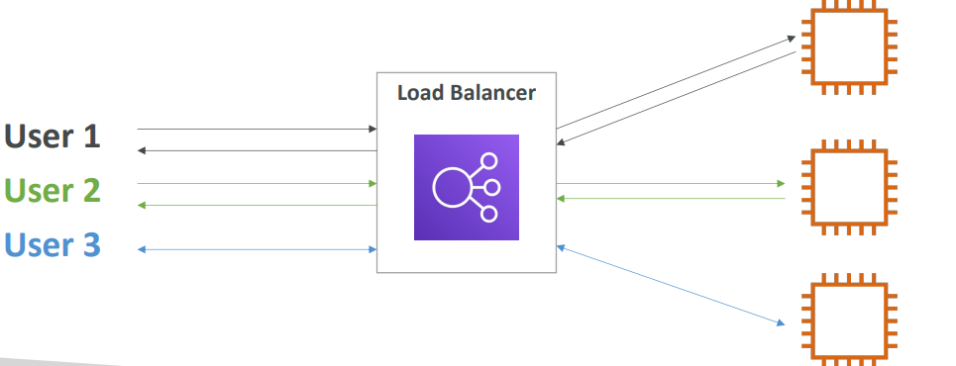
What is load balancing?
Load balancers are servers that forward internet traffic to multiple servers (EC2 Instances) downstream.

Slide 9
Why use a load balancer?
• Spread load across multiple downstream instances
• Expose a single point of access (DNS) to your application
• Seamlessly handle failures of downstream instances
• Do regular health checks to your instances
• Provide SSL termination (HTTPS) for your websites
• High availability across zones

Slide 10
Why use an Elastic Load Balancer?
An ELB (Elastic Load Balancer) is a managed load balancer
AWS guarantees that it will be working
AWS takes care of upgrades, maintenance, high availability
AWS provides only a few configuration
It costs less to setup your own load balancer but it will be a lot more effort on your end (maintenance, integrations)
4 kinds of load balancers offered by AWS:
Application Load Balancer (HTTP / HTTPS only) – Layer 7
Network Load Balancer (ultra-high performance, allows for TCP) – Layer 4
Gateway Load Balancer – Layer 3
Classic Load Balancer (retired in 2023) – Layer 4 & 7

Slide 11
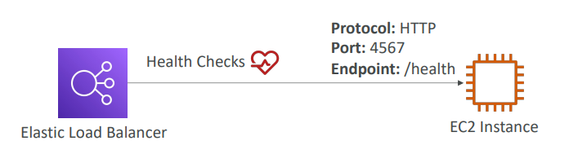
Health Checks
• Health Checks are crucial for Load Balancers
• They enable the load balancer to know if instances it forwards traffic to are available to reply to requests
• The health check is done on a port and a route (/health is common)
• If the response is not 200 (OK), then the instance is unhealthy

Slide 12
Types of load balancer on AWS
• AWS has 4 kinds of managed Load Balancers
• Classic Load Balancer (v1 - old generation) – 2009 – CLB
HTTP, HTTPS, TCP, SSL (secure TCP)
• Application Load Balancer (v2 - new generation) – 2016 – ALB
HTTP, HTTPS, WebSocket
• Network Load Balancer (v2 - new generation) – 2017 – NLB
TCP, TLS (secure TCP), UDP
• Gateway Load Balancer – 2020 – GWLB
Operates at layer 3 (Network layer) – IP Protocol
• Overall, it is recommended to use the newer generation load balancers as they
provide more features
• Some load balancers can be setup as internal (private) or external (public) ELBs

Slide 13
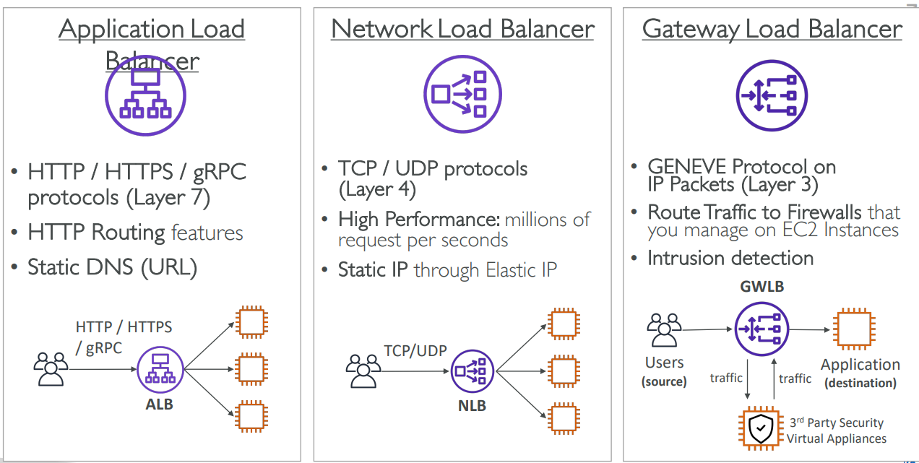

Slide 14
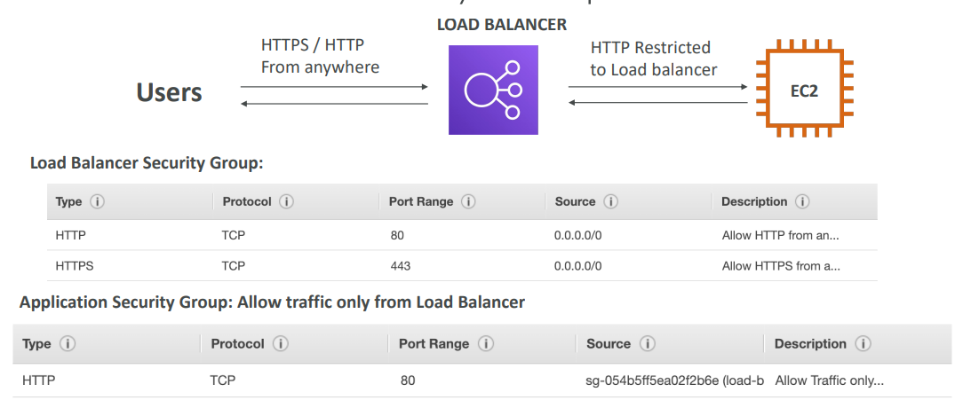
Load Balancer Security Groups

Slide 15
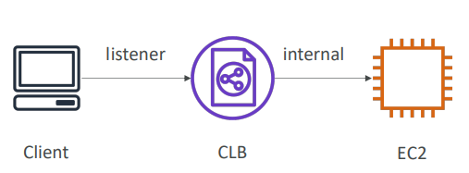
Classic Load Balancers (v1)
• Supports TCP (Layer 4), HTTP &
HTTPS (Layer 7)
• Health checks are TCP or HTTP
based
• Fixed hostname
XXX.region.elb.amazonaws.com

Slide 16
Application Load Balancer (v2)
• Application load balancers is Layer 7 (HTTP)
• Load balancing to multiple HTTP applications across machines (target groups)
• Load balancing to multiple applications on the same machine (ex: containers)
• Support for HTTP/2 and WebSocket
• Support redirects (from HTTP to HTTPS for example)
• Routing tables to different target groups:
Routing based on path in URL (example.com/users & example.com/posts)
Routing based on hostname in URL (one.example.com & other.example.com)
Routing based on Query String, Headers (example.com/users?id=123&order=false)

Slide 17
Application Load Balancer (v2)
Target Groups
• EC2 instances (can be managed by an Auto Scaling Group) – HTTP
• ECS tasks (managed by ECS itself) – HTTP
• Lambda functions – HTTP request is translated into a JSON event
• IP Addresses – must be private Ips
• ALB can route to multiple target groups
• Health checks are at the target group level

Slide 18
Network Load Balancer (v2)
• Network load balancers (Layer 4) allow to:
Forward TCP & UDP traffic to your instances
Handle millions of request per seconds
Ultra-low latency
• NLB has one static IP per AZ, and supports assigning Elastic IP
(helpful for whitelisting specific IP)
• NLB are used for extreme performance, TCP or UDP traffic
• Not included in the AWS free tier

Slide 19
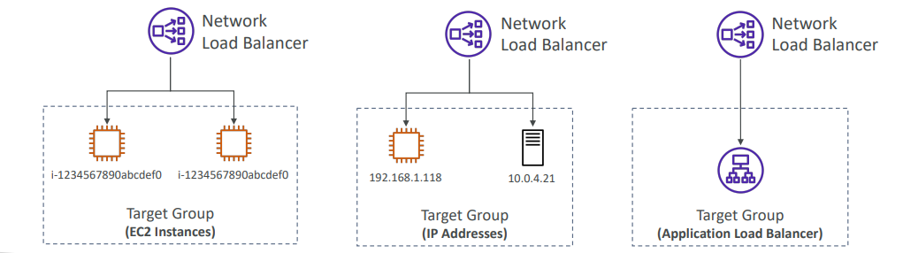
Network Load Balancer –Target Groups
• EC2 instances
• IP Addresses – must be private IPs
• Application Load Balancer
• Health Checks support the TCP, HTTP and HTTPS Protocols

Slide 20
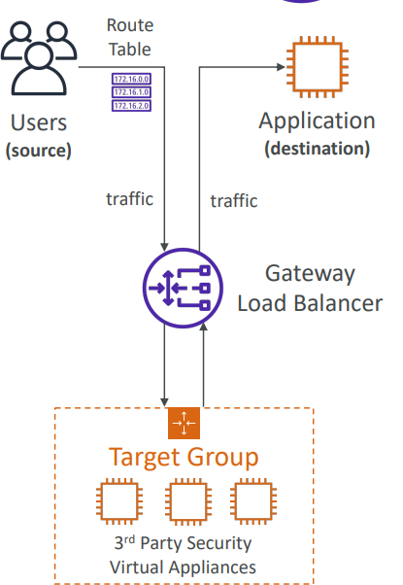
Gateway Load Balancer
• Deploy, scale, and manage a fleet of 3rd party network virtual appliances in AWS
• Example: Firewalls, Intrusion Detection and Prevention Systems, Deep Packet Inspection
Systems, payload manipulation, …
• Operates at Layer 3 (Network Layer) – IP Packets
• Combines the following functions:
Transparent Network Gateway – single entry/exit for all traffic
Load Balancer – distributes traffic to your virtual appliances
• Uses the GENEVE protocol on port 6081

Slide 21
SSL/TLS – Basics
• An SSL Certificate allows traffic between your clients and your load balancer
to be encrypted in transit (in-flight encryption)
• SSL refers to Secure Sockets Layer, used to encrypt connections
• TLS refers to Transport Layer Security, which is a newer version
• Nowadays, TLS certificates are mainly used, but people still refer as SSL
• Public SSL certificates are issued by Certificate Authorities (CA)
• Comodo, Symantec, GoDaddy, GlobalSign, Digicert, Letsencrypt, etc…
• SSL certificates have an expiration date (you set) and must be renewed

Slide 22
What’s an Auto Scaling Group?
• In real-life, the load on your websites and application can change
• In the cloud, you can create and get rid of servers very quickly
• The goal of an Auto Scaling Group (ASG) is to:
Scale out (add EC2 instances) to match an increased load
Scale in (remove EC2 instances) to match a decreased load
Ensure we have a minimum and a maximum number of machines running
Automatically register new instances to a load balancer
Replace unhealthy instances
• Cost Savings: only run at an optimal capacity (principle of the cloud)

Slide 23
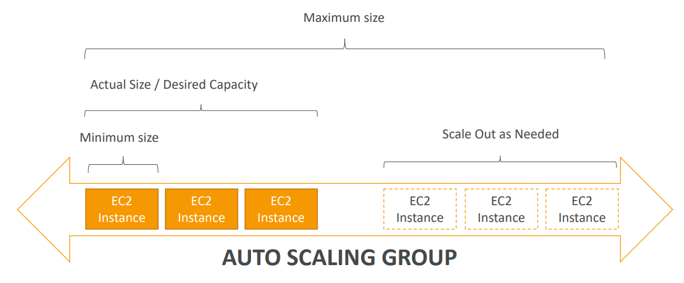
Auto Scaling Group in AWS

Slide 24
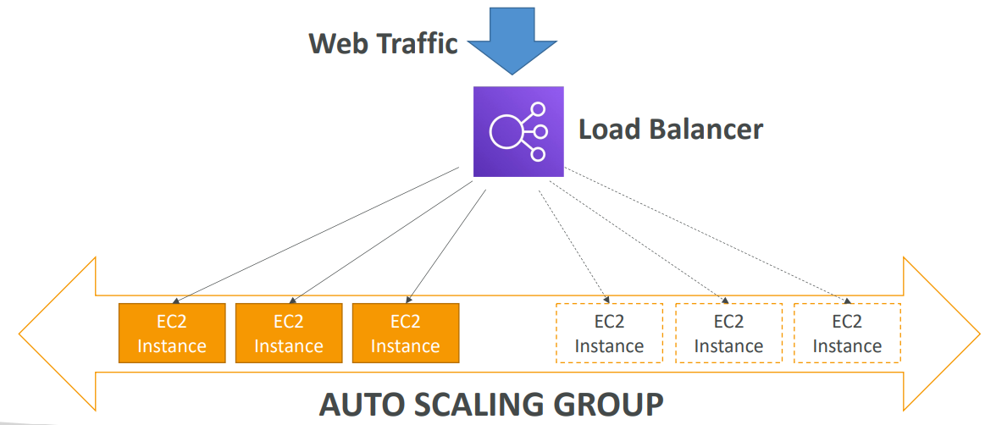
Auto Scaling Group in AWS With Load Balancer

Slide 25
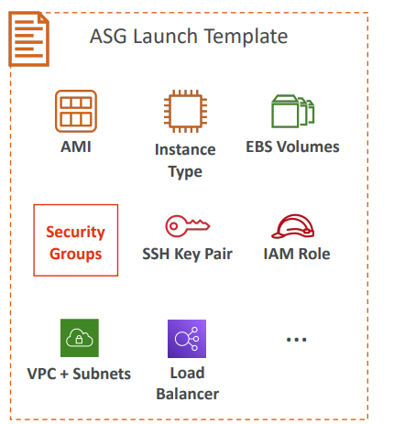
Auto Scaling Group Attributes • A Launch Template (older “Launch Configurations” are deprecated)
AMI + Instance Type
EC2 User Data
EBS Volumes
Security Groups
SSH Key Pair
IAM Roles for your EC2 Instances
Network + Subnets Information
Load Balancer Information
• Min Size / Max Size / Initial Capacity
• Scaling Policies

Slide 26
Auto Scaling Groups – Scaling Strategies
Manual Scaling: Update the size of an ASG manually
Dynamic Scaling: Respond to changing demand
Simple / Step Scaling
When a CloudWatch alarm is triggered (example CPU > 70%), then add 2 units
When a CloudWatch alarm is triggered (example CPU < 30%), then remove 1
Target Tracking Scaling
Simple to set-up
Example: I want the average ASG CPU to stay at around 40%
Scheduled Scaling
Anticipate a scaling based on known usage patterns
Example: increase the min. capacity to 10 at 5 pm on Fridays

Slide 27
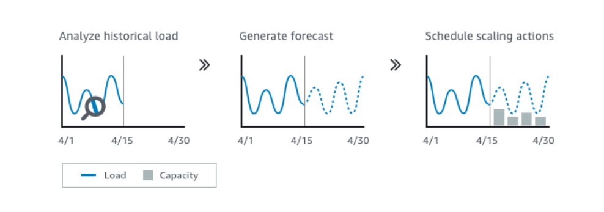
Auto Scaling Groups – Scaling Strategies
Predictive scaling:
Continuously forecast load and schedule scaling ahead
Automatically provisions the right number of EC2 instances in advance
Useful when your load has predictable time - based patterns

Slide 28
ELB & ASG – Summary
High Availability vs Scalability (vertical and horizontal) vs Elasticity
Elastic Load Balancers (ELB)
Distribute traffic across backend EC2 instances, can be Multi-AZ
Supports health checks
4 types: Classic (old), Application (HTTP – L7), Network (TCP – L4), Gateway (L3)
Auto Scaling Groups (ASG)
Implement Elasticity for your application, across multiple AZ
Scale EC2 instances based on the demand on your system, replace unhealthy
Integrated with the ELB

